Slide 1

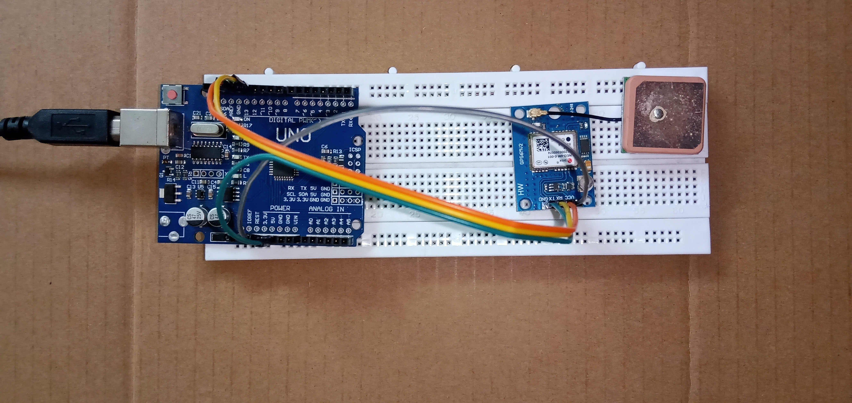
GPS Tracking System
By- Kartikeya Kushwaha
Roll no. 1900320310073
Branch: ECE-B

Slide 2
CONTENT 1) Introduction 2) Hardware Overview 3) Circuit Diagram 4) Working 5) Actual Hardware 6) Code 7) Screenshots of Serial Monitor
INTRODUCTION
What is GPS?
The Global Positioning System (GPS) is a satellite-based navigation system made up of at least 24 satellites. GPS works in any weather conditions, anywhere in the world, 24 hours a day, with no subscription fees or setup charges.
How does GPS work?
GPS receivers actually work by figuring out how far they are from a number of satellites. They are pre-programmed to know where the GPS satellites are at any given time.
The satellites transmit information about their position and the current time in the form of radio signals towards the Earth. These signals identify the satellites and tell the receiver where they are located. The receiver then calculates how far away each satellite is by figuring out how long it took for the signals to arrive.

Slide 3
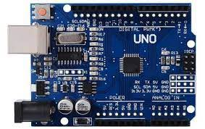
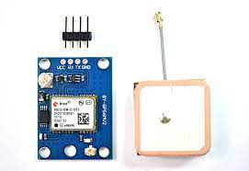

Hardware Used
UBLOX NEO-6M GPS Module
Arduino UNO
Jumper Wires
Breadboard
3.0V USB Cable
Arduino IDE

Slide 4
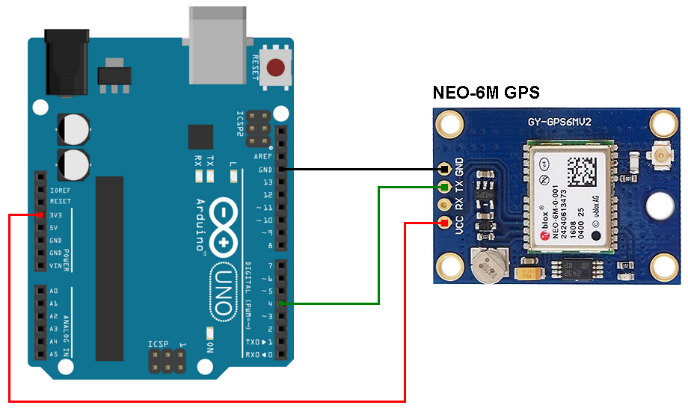
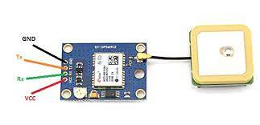
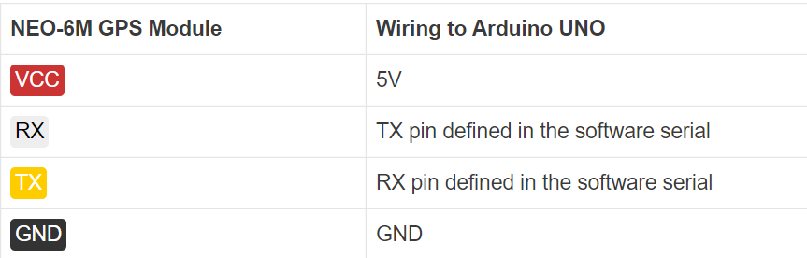
Circuit Diagram

Slide 5
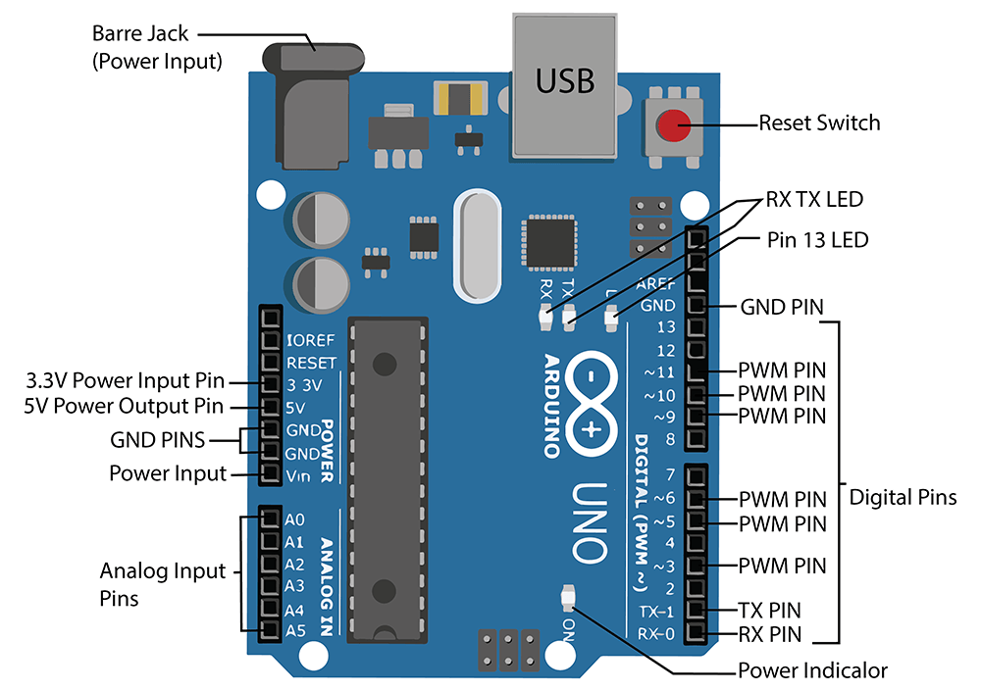
Pin Diagram of Arduino UNO

Slide 6
Connection And Working
We start by connecting the patch antenna to the U.FL connector on the GPS module. We also need to solder the pins of module for better connection.
Now, connect Tx and Rx pin on module to digital pin#2 and #3 respectively on Arduino which will help the module to connect with Arduino.
Next, connect VCC pin to the 3.3V pin on the Arduino and GND to ground. After this the connection is done. We have to write and compile the code through IDE.
After successful compilation of code, the GPS module transmit data about its location to satellites which they have been locked to and tell the receiver where the module is located. Receiver then calculates how far away each satellite is by figuring out how long it took for the signals to arrive. Once it has information on how far away at least three satellites are and where they are in space, it can pinpoint your location on Earth. And the at Serial port we are given with NMEA data which will help to find latitude and longitude.
Give the Arduino’s ability to sense locations with NEO-6M GPS Module that can track up to 22 satellites and identifies locations anywhere in the world.

Slide 7
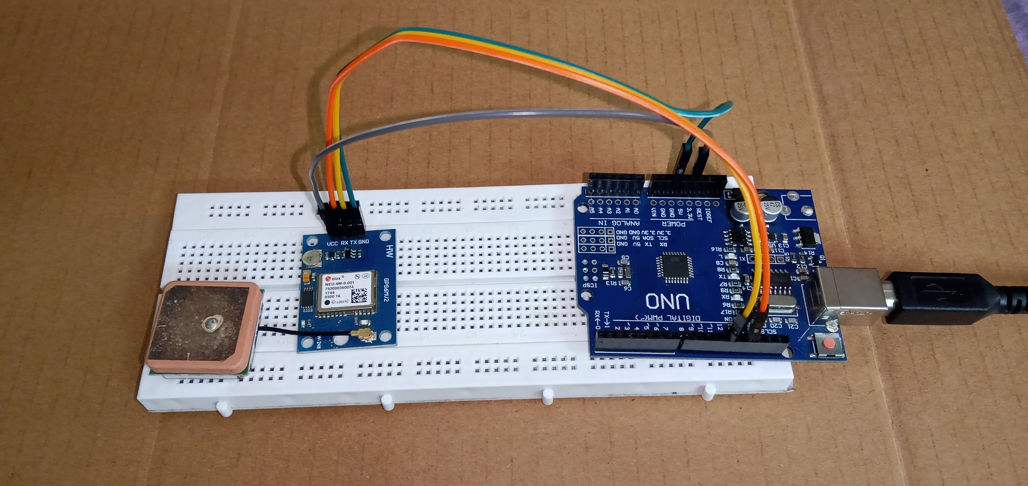
Actual Hardware

Slide 8
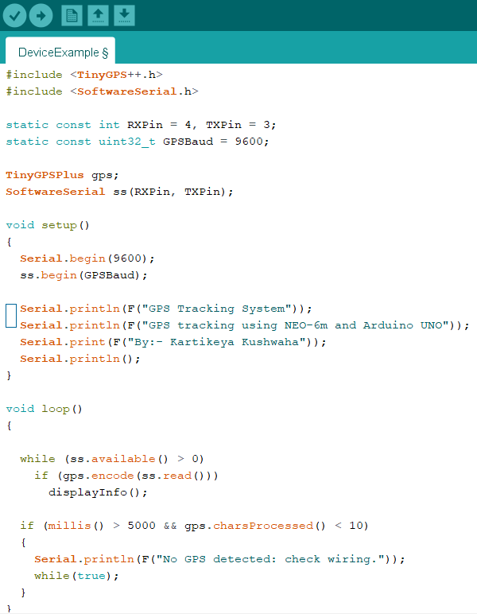
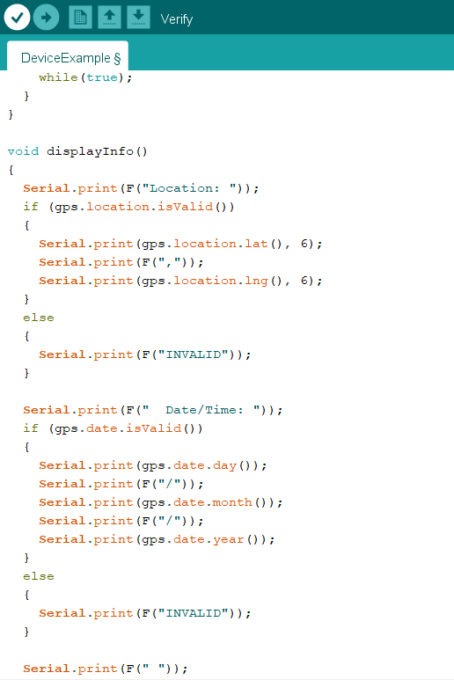
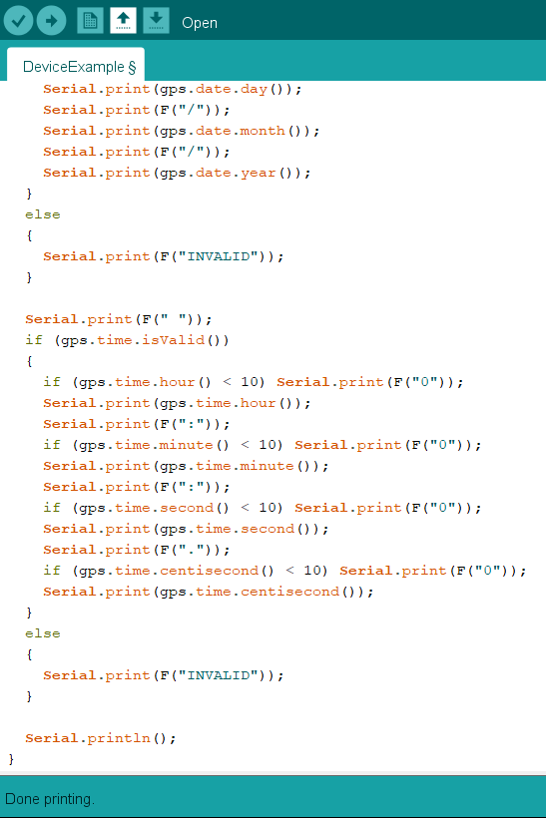
Implemented Code

Slide 9
Screenshots of Result
This is screenshot of Serial monitor and here we can see the project name, description and the creator’s name.
Starting from 4th line, first time is specified after that location denotes longitude and latitude of the location of GPS module i.e. my home. And further in line we can see todays date.
Now we can search these location data on google and my current location will be displayed on the map.

Slide 10
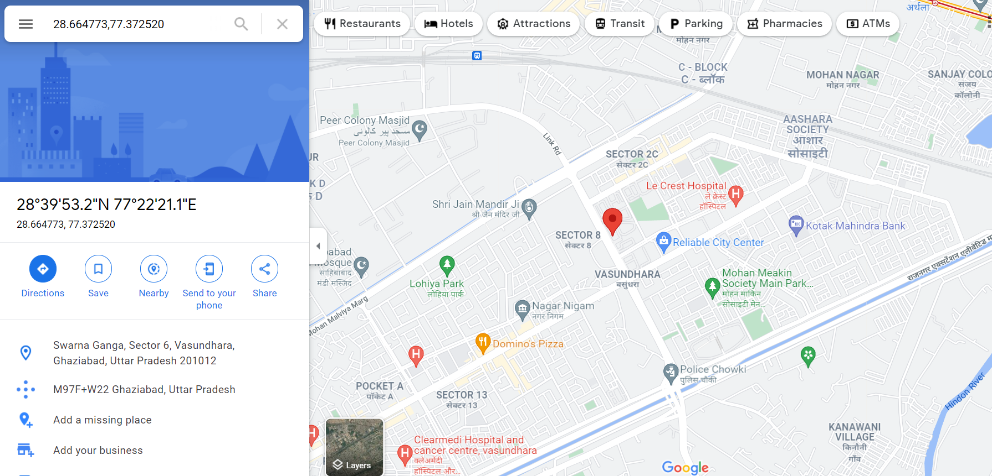

Slide 11
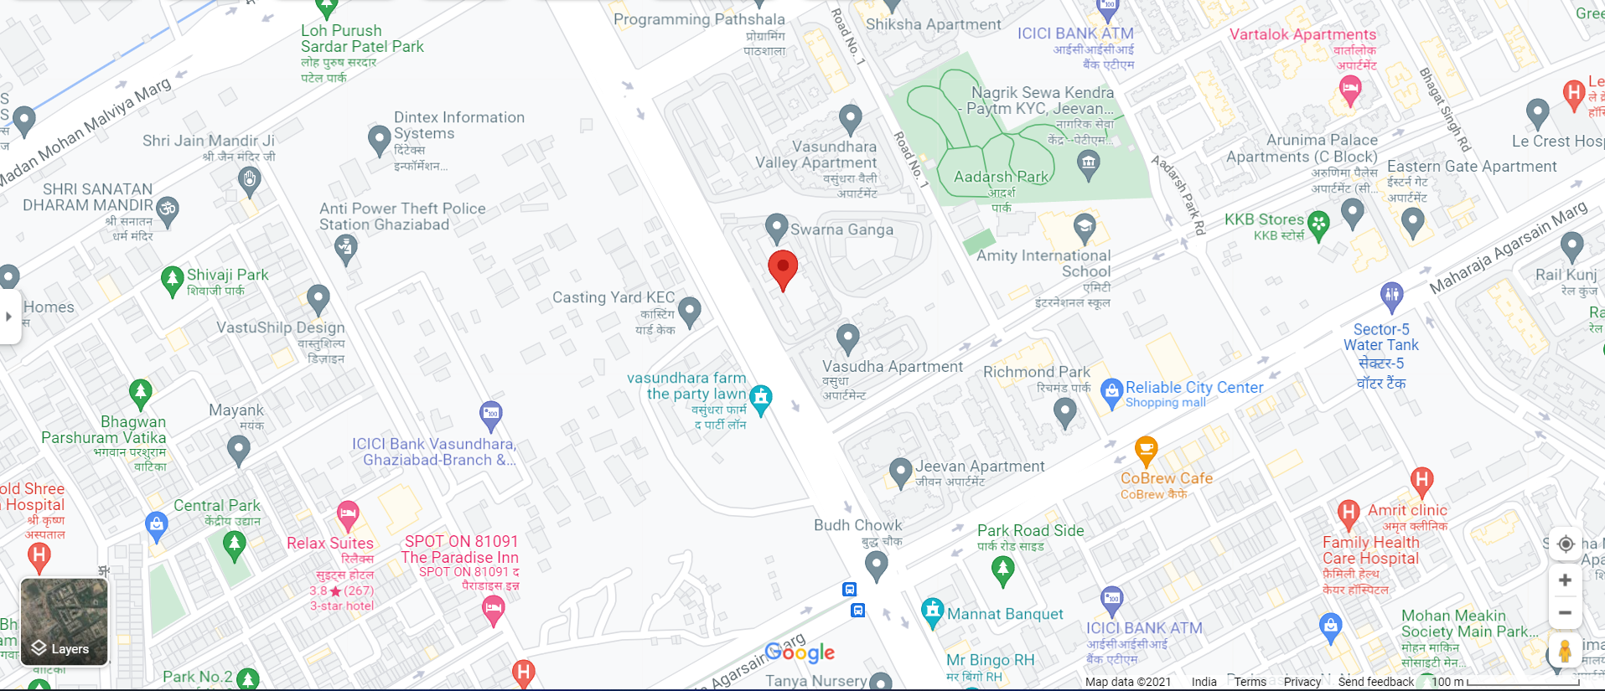

Slide 12
Conclusion
We discovered our location using a simple yet sophisticated device with little bit of programming and hardware knowledge.
And further we can also implement this project on PCB board with the use of much less instruments and it will a fully become a portal GPS tracker which will provide precise location.
Thank you.
Kartikeya Kushwaha

